Slide 1
IDS 494-PYTHON FOR DATA SCIENCE A STUDY ON “FLIGHT DELAYS”
Group Members:
RUITING CHEN
DEVYANI SINGH
TARUN KHURANA

Slide 2
AGENDA
INTRODUCTION
THE PROBLEM AND ITS IMPORTANCE
ALL ABOUT THE DATASETS
THE ROADBLOCK!!
PREPARING THE DATA
CLEANING THE DATA
MERGING THE DATA
DESCRIPTIVE STATISTICS
MODELING
CONCLUSION

Slide 3
INTRODUCTION

Slide 4
THE PROBLEM AND ITS IMPORTANCE
Now a days ,with quite a lot of airlines operating, it has become really necessary to have some kind of predictive analysis in hand so has to select the best one possible at an economical price. Hence, the problem we will considering in our final study is
How much will a flight will probably be delayed
AND
What may be the possible reasons for the same

Slide 5
ALL ABOUT THE DATASETS
We are considering the delay datasets for the year 2015 for the airlines flying in the United States
We have the following three datasets:
Flights Dataset-The MAIN dataset ,has 5819079 rows and 31 columns in raw form
Airline Dataset- The dataset has a list of all the airlines operating in the United States
Airport Dataset-The dataset has a list of all the airports currently in the United States
Here is the list of few of the important variables in the main dataset when in raw form
YEAR, MONTH, DAY, DAY_OF_WEEK: dates of the flight
AIRLINE: an identification number assigned by us dot to identify a unique airline
ORIGIN_AIRPORT,DESTINATION_AIRPORT: code attributed by iata to identify the airports
SCHEDULED_DEPARTURE,SCHEDULED_ARRIVAL : scheduled times of take-off and landing
DEPARTURE_TIME,ARRIVAL_TIME: real times at which take-off and landing took place
DEPARTURE_DELAY,ARRIVAL_DELAY: difference (in minutes) between planned and real times
DISTANCE: distance (in miles)
The datasets can be found here: https://www.transtats.bts.gov/DL_SelectFields.asp?Table_ID=236

Slide 6
THE FIRST ROADBLOCK (BEFORE ANYTHING STARTED!)
The first roadblock we faced while trying to load our main dataset, a file with more than 58 million rows, in our 32 bit PYTHON IDE was that of a low memory timeout which not only resulted in extensive load on the CPU’s processor, resulting in pausing the windows for quite a few number of times but also absorbed 5 days of our project(before even starting!!)
THE SOLUTION
After googling all over the internet ,we found that a 32 bit PYTHON IDLE can maximum be allowed to have 2 GB RAM at once which was quite less than what out dataset wanted.
We uninstalled the 32 bit PYTHON IDLE version only to install the 64 bit PYTHON IDLE version which resulted in the smooth execution of loading the dataset as the 64 bit PYTHON had no upper limit for the memory

Slide 7
PREPARING THE DATA
CLEANING THE DATA
MERGING THE DATA

Slide 8
CLEANING THE DATASET
After the successful loading the flights dataset we started working on cleaning the dataset
The following steps were followed:
Step1: Combine columns like YEAR, MONTH, DAY etc to create a DATE column
Step 2: Formatting various columns in time format
Created a function to change the format of many delay type columns like SCHEDULED_DEPARTURE, DEPARTURE_TIME to have an exact time of the day
Step 3: Removing unwanted columns like YEAR, MONTH, DAY etc
Step 4-Deleting/Replacing blank value rows ,that is, handling NA’s and CANCELLED/DIVERTED flights as they won't affect delays
Step 5-The last was rearranging the columns in order to better understand the dataset

Slide 9
MERGING THE DATA
The main dataset had just the code instead of the airline name which made us merge the two datasets ,that is ,airlines and flights for the easy understanding of the datasets.

Slide 10
DESCRIPTIVE ANALYSIS STUDYING THE DATASETS

Slide 11
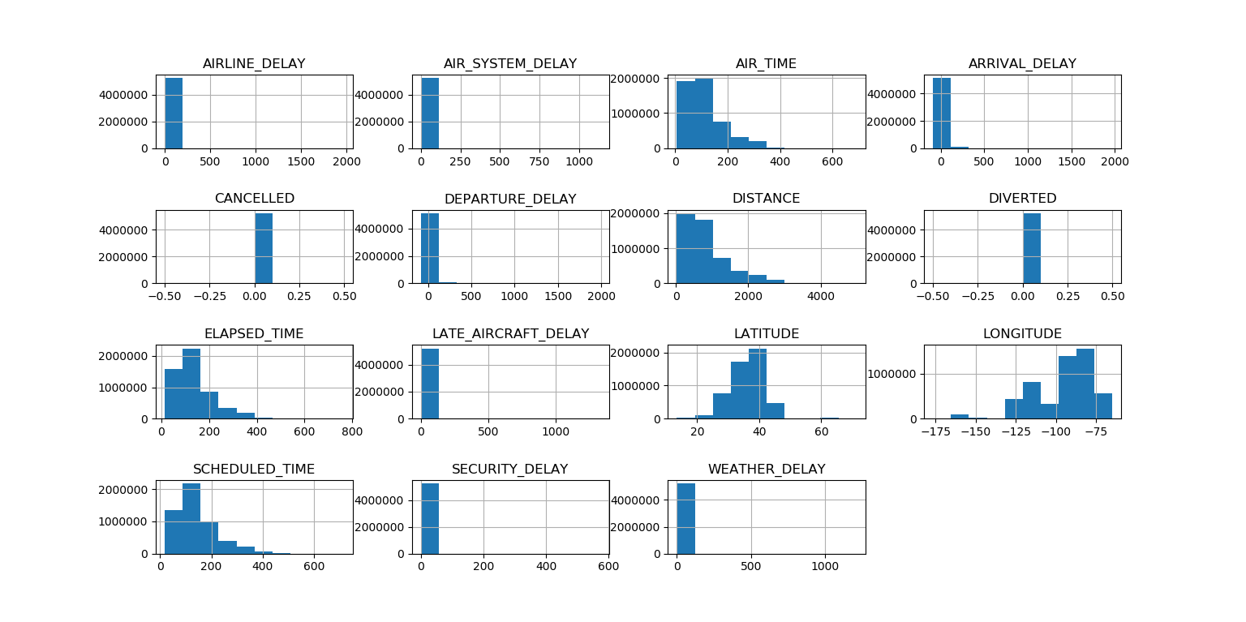
NUMERICAL DATA ANALYSIS
Visual snapshot of all the numerical data

Slide 12
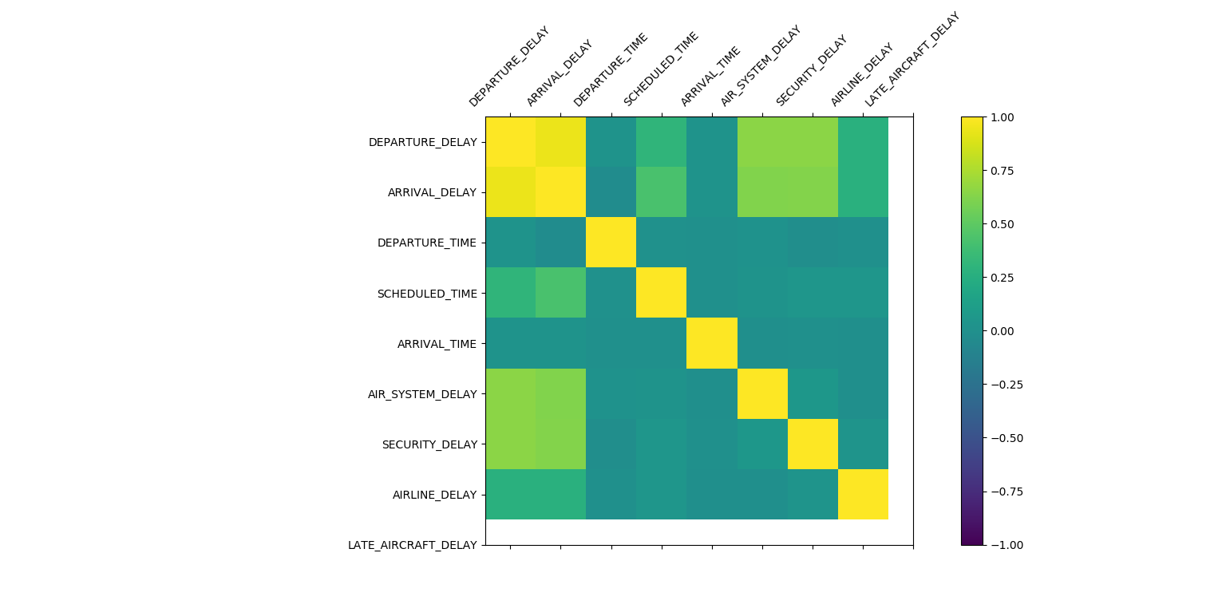
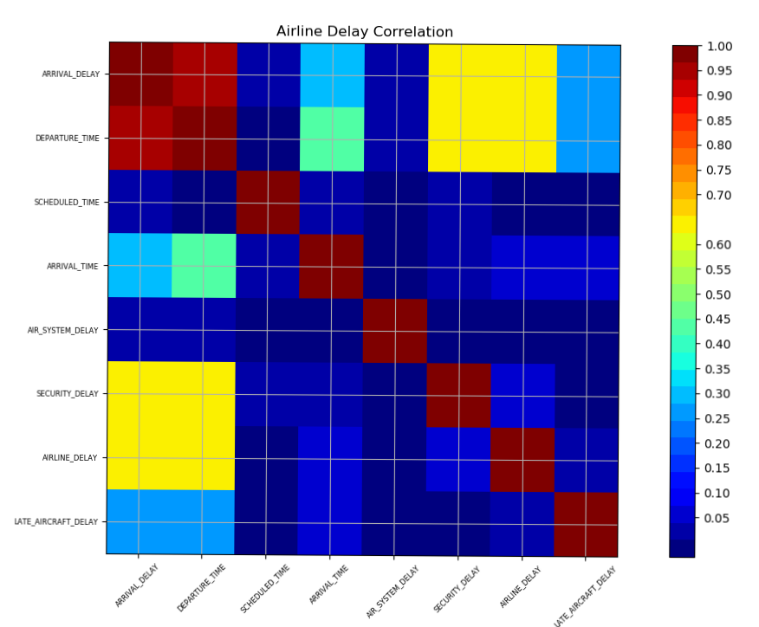
Displaying Correlation Matrix of all numerical data to visualize their relationships.

Slide 13
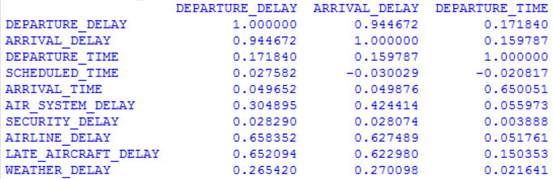
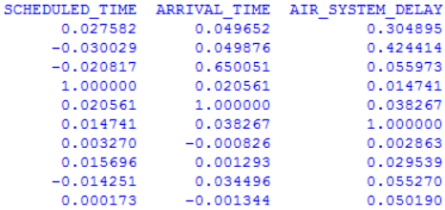
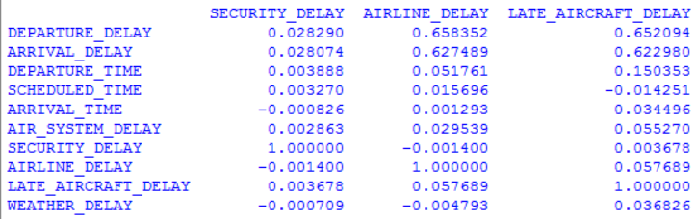
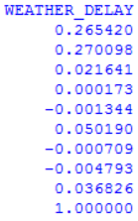
Analysis
From Correlation Matrix,
we see that a strong correlation exists between departure delay , arrival delay and late aircraft delay.
we see that a strong correlation exists between departure delay , arrival delay and airline delay.
Some direct correlation like departure delay to arrival delay also exists.

Slide 14
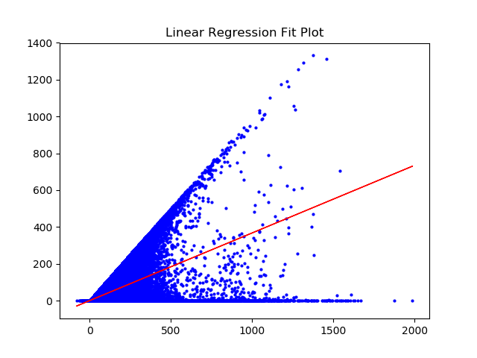
Linear Regression
From correlation matrix we found out that Late Air craft delay shows some relation with departure and arrival delay.
Plot of linear regression between late aircraft delay and departure delay
Analysis- Positive relationship exists. Whenever the delay is because of the aircraft, the flight departure will be delayed.

Slide 15
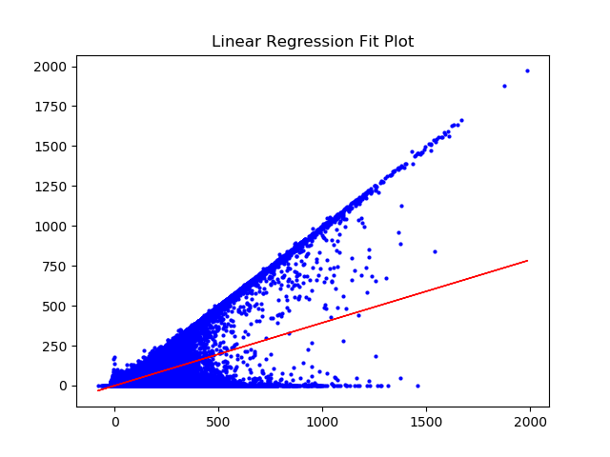
Linear Regression
From correlation matrix we found out that Airline delay shows some relation with departure and arrival delay.
Plot of linear regression between airline delay and departure delay
Analysis- Positive relationship exists. Whenever the delay is because of the airline, the flight departure will be delayed.

Slide 16
CATEGORICAL DATA ANALYSIS
Two data variables in consideration:
Airlines
Airports

Slide 17
AIRLINES DATASET
We believed that higher the flights count of the airline more should be the delay because of which we tried finding the airlines that flew the most in United States for the year 2015 in order to see if the count of flights has any role to play in it being delayed.
RESULTS
Airline with the maximum number of FLIGHTS ('WN', 1242403) where WN is Southwest Airlines

Slide 18
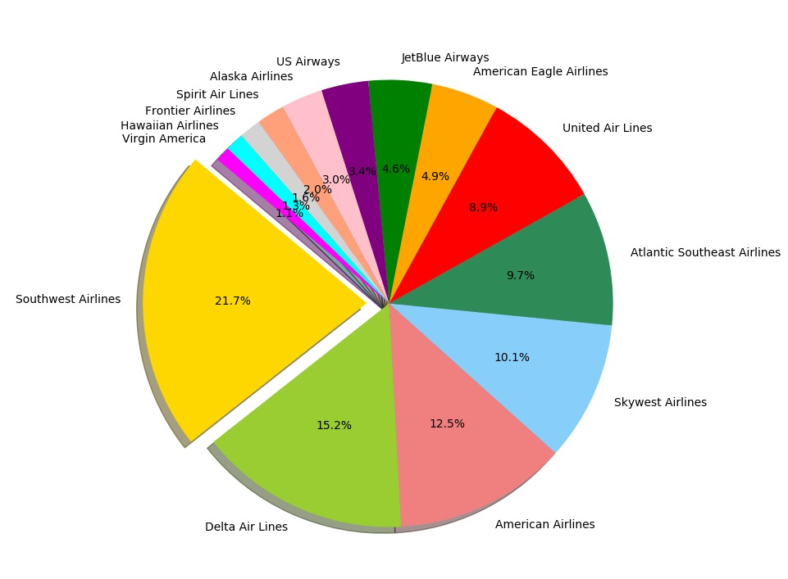
Here is the pie chart depicting the count of flights each airlines operated in the year 2015
From the graph we can see that the Southwest airlines has the highest percentage of flights operating in the United States for the year 2015 followed by Delta airlines and American airlines with 15.2% and 12.5% respectively

Slide 19
Analysis
As Southwest airlines co. has the maximum flights count in the United States,we tried finding if the Southwest airlines co. also has the maximum average delay
Calculating the total average delay of each airline we find that the airline codes as ‘NK’ has the highest delay, which is not Southwest Airlines

Slide 20
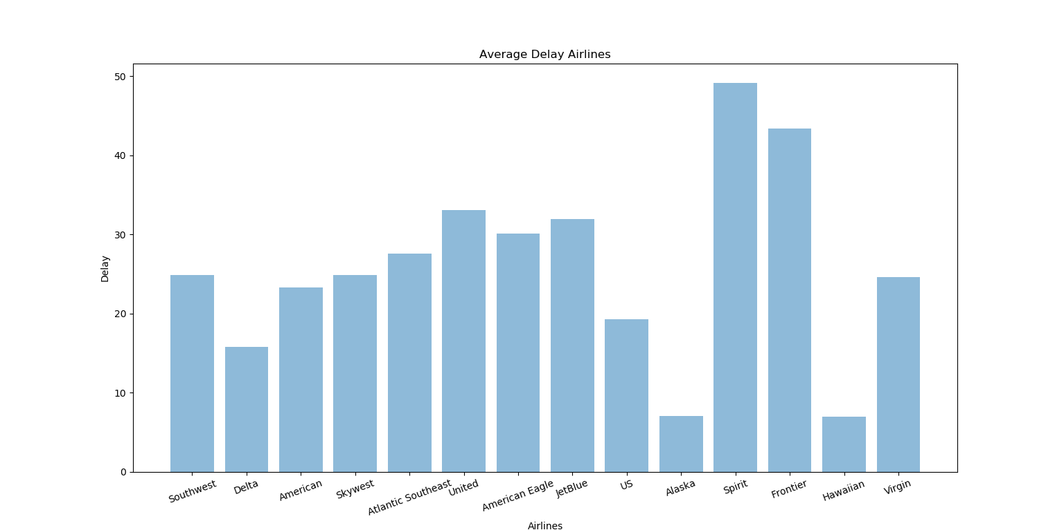
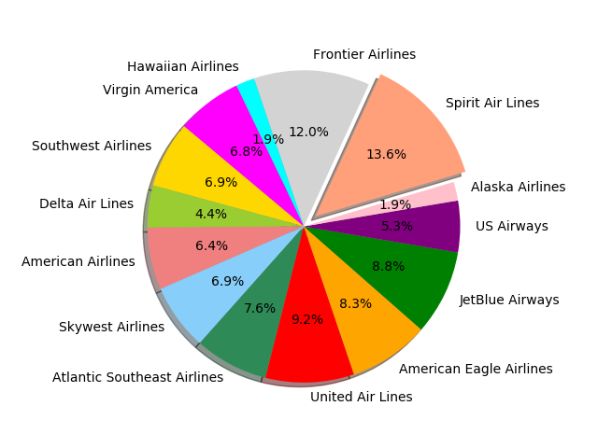
Here is a plot stating the average delays of each airline

Slide 21
After plotting we find out that Southwest airlines co. may have the maximum number of flights running in the United States but it does not account for the maximum average delay
On the other hand, we noticed that the frontier airlines has the maximum average delay

Slide 22
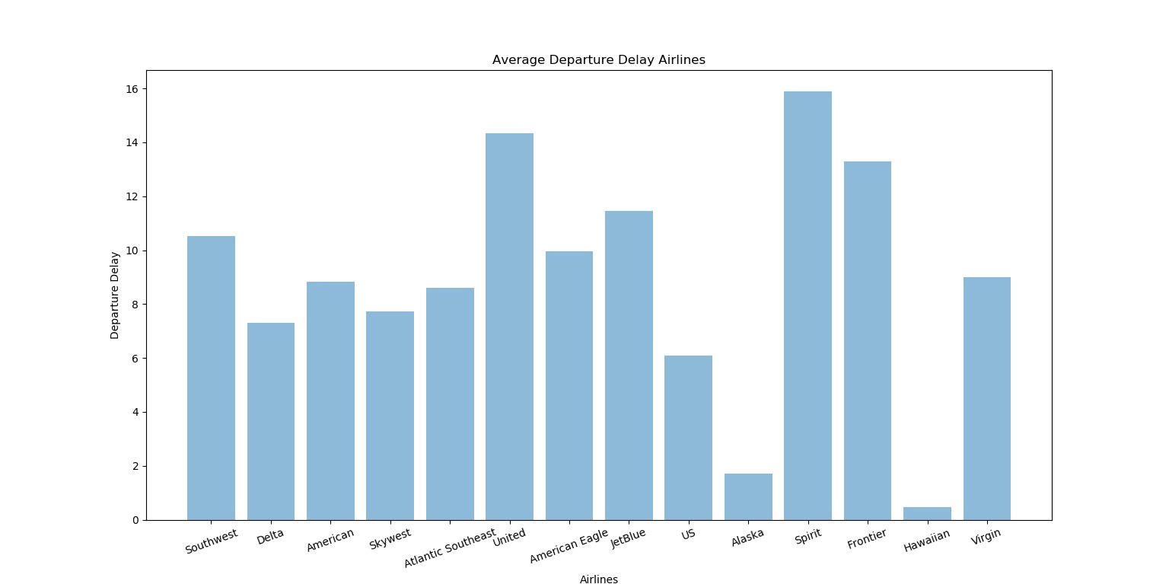
Breaking the delay in two parts, departure delay and arrival delay to analyze them separately

Slide 23
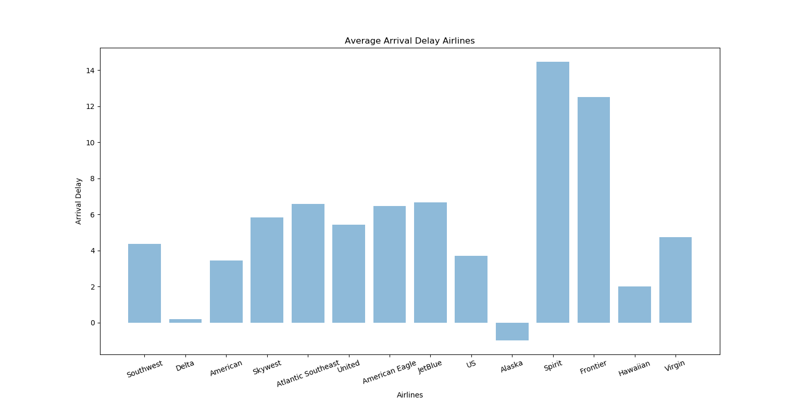

Slide 24
CONCLUSION-AIRLINES DATASET
After looking at the total flights number pie chart , we conclude that southwest airlines co. has the maximum number of flights flying in the year 2015 but does not play much of a role in the delays
Also, we conclude that although spirit(2%),frontier(1.6%) and united(8.8%) airlines hold very less share in the same plot ,they are the main contributors in the delays for the year 2015.
Here is some information about the airlines causing the most delays
The maximum average delay are spirit, frontier and united airlines respectively
The maximum departure delay are spirit, united and frontier airlines respectively
The maximum arrival delay are spirit, frontier and JetBlue airlines respectively.

Slide 25
AIRPORTS DATASET
Lets shift our attention to the airports now to find the busiest origin airport and destination airport
RESULTS
Busiest Origin Airport ('ATL', 343506)
Busiest Destination Airport ('ATL', 343076)
where ‘ATL’ is the Atlanta airport

Slide 26
Now let us try to see if the busiest airport is the airport with the most delays
Calculating the airport with the maximum average delay we find that the airport called Wilmington Airport has highest delay, which is not Atlanta airport(the busiest airport).
Note: as the count of number of airports is more than 300,showing a plot would make no sense, hence we tried creating plot of all the airports on the map on United States.

Slide 27
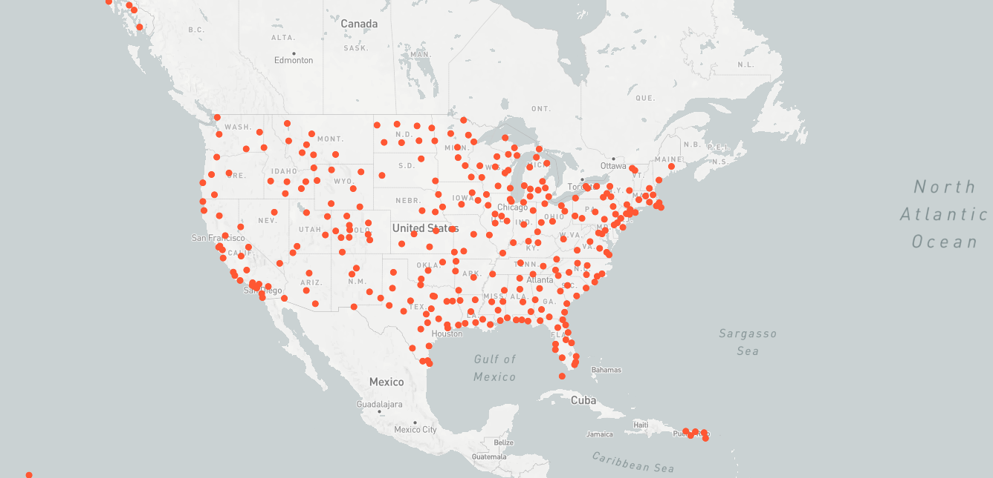
AIRPORTS ON THE MAP OF UNITED STATES

Slide 28
MODELING
CLUSTER
TIME SERIES
FIXED EFFECT
RANDOM FOREST

Slide 29
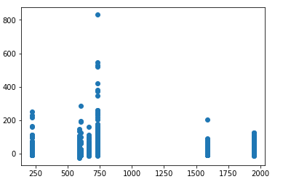
CLUSTER
Distance and Flight Delay

Slide 30
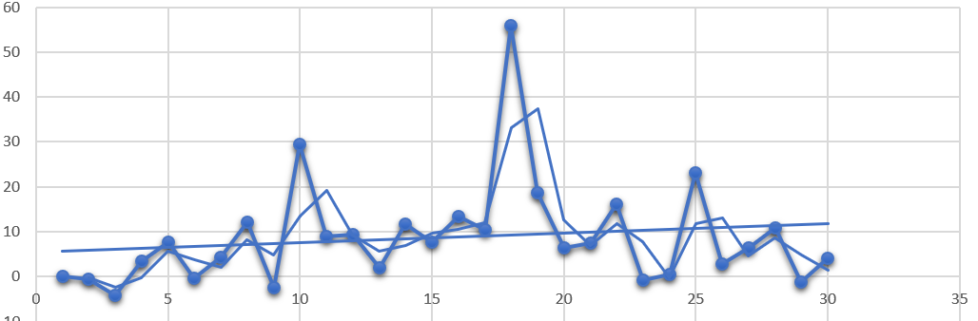
TIME SERIES

Slide 31



FIXED EFFECT
Day of week, Departure time and Departure delay
Linear regression doesn’t work
Formula
For
Matrix for i: Separate a day(24 hours) into 96
Matrix for t: everyday
Count Avg
For
Matrix for erro

Slide 32
RANDOM FOREST
Medium data size
Categorical nature of many variables
Non-linearity of dataset (Linear Regression was attempted but had high MSE; Linear relation doesn't exist for many variables)
Underlying complex dependencies between variables
Non-parameteric approach without much assumptions

Slide 33
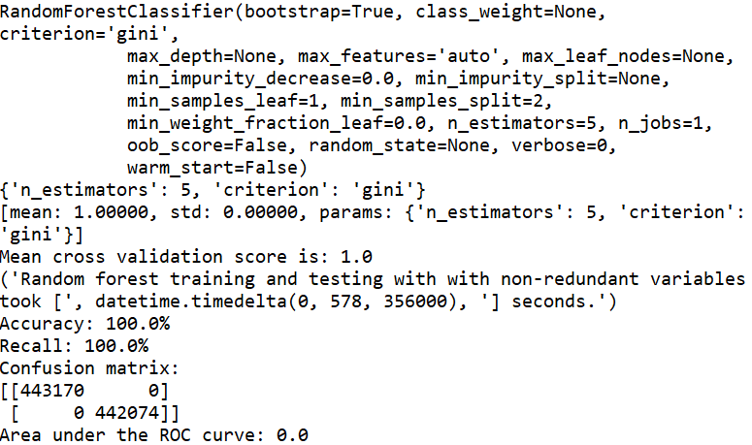
Training : Testing 8:2
Dimension : 27

Slide 34
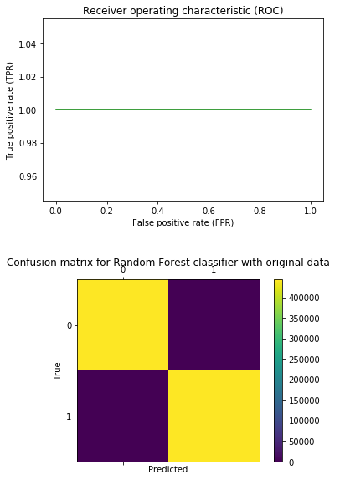

Slide 35
CONCLUSION
Working and understanding such a large dataset was difficult.
We learnt about the following packages:
Pandas, Numpy, Datetime, CSV, Plotly, Matplotlib, Scipy, Sklearn.
From the descriptive analysis of the data we can visualize the data variables and see potential relationships.
From the modelling analysis of the data we learnt models and saw different trends in different relationships

